Slide 1
Solo Project: 1337 Library
Week 8 Submission

Slide 2
Brief
2 tables
Full CRUD functionality
Utilize OOP principles
Test thoroughly

Slide 3
The Solution
Create a website that acted as a game library
1 table for games, 1 table for publishers

Slide 4
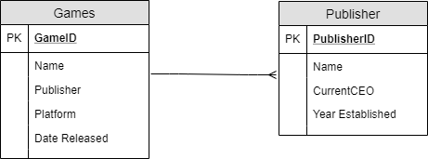
The Solution – ER Diagrams

Slide 5
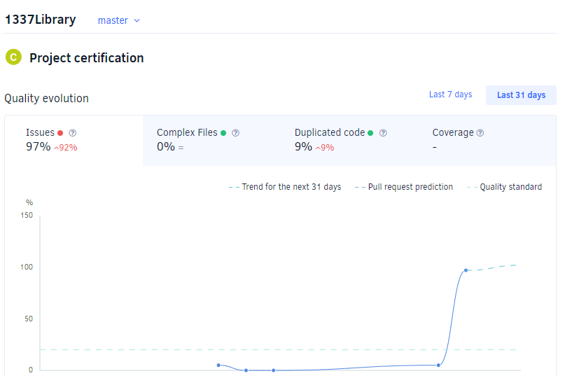
Static Testing

Slide 6
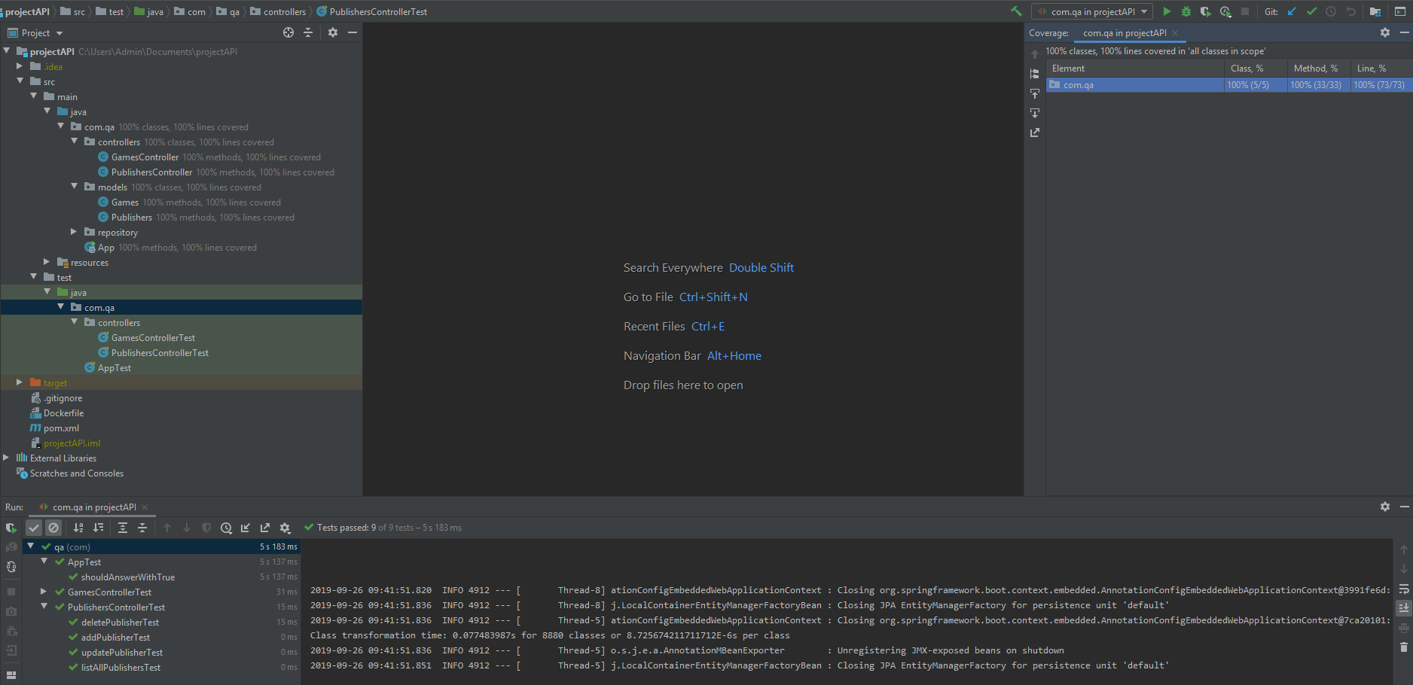
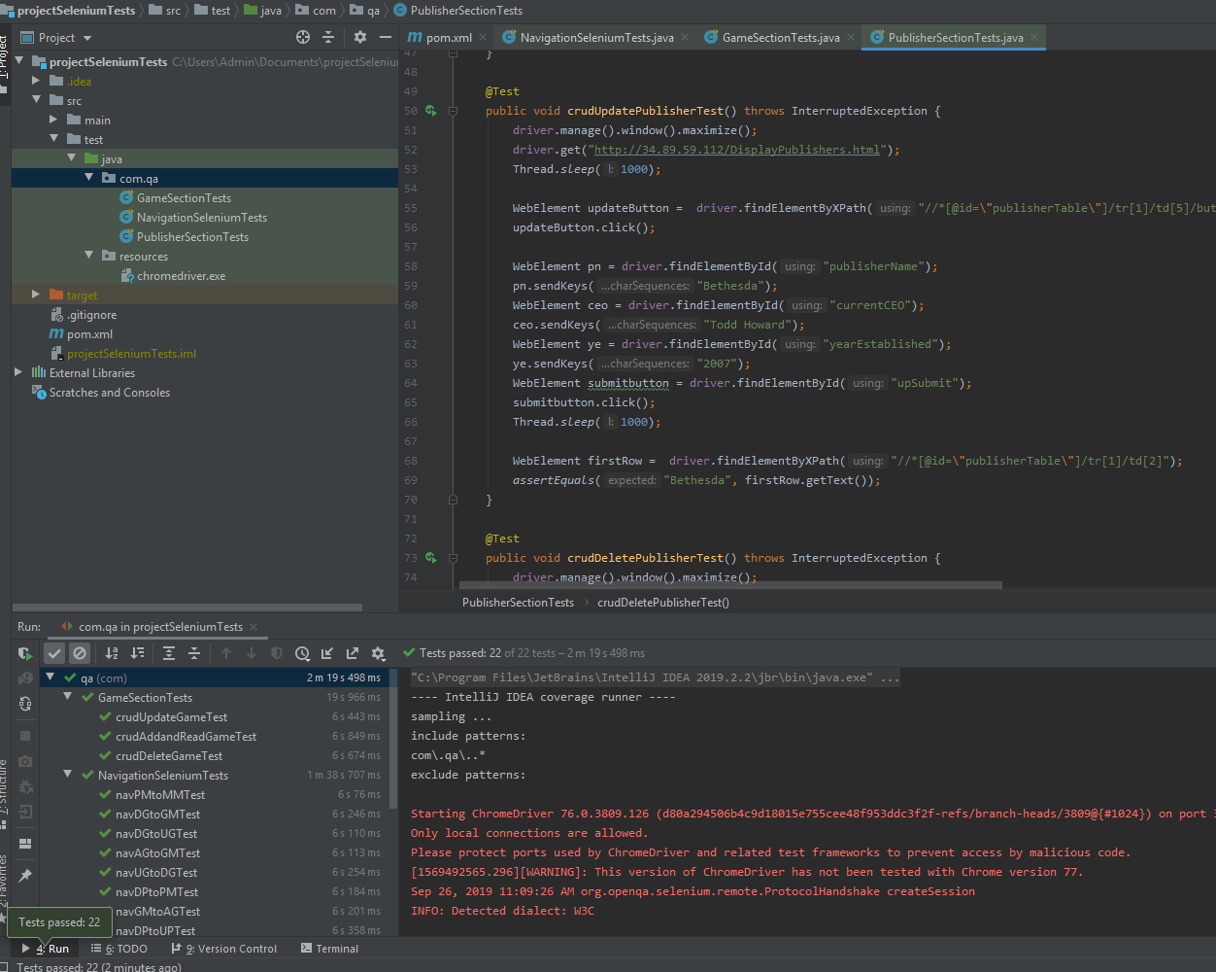
Dynamic Testing

Slide 7
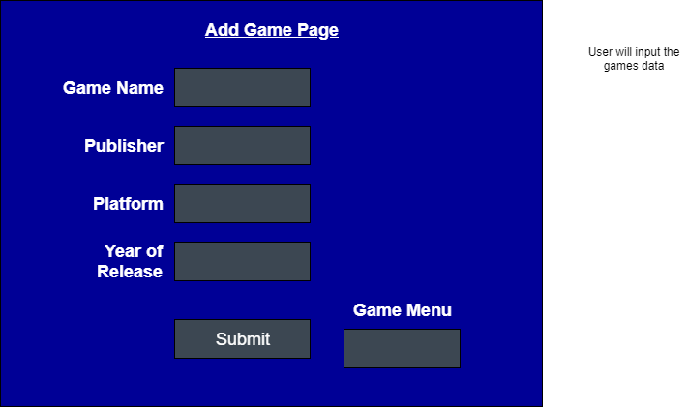
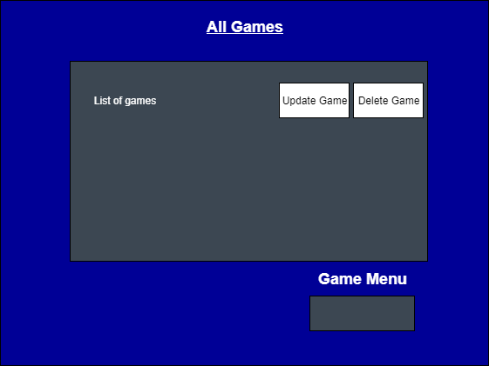
Front End - Wireframes

Slide 8
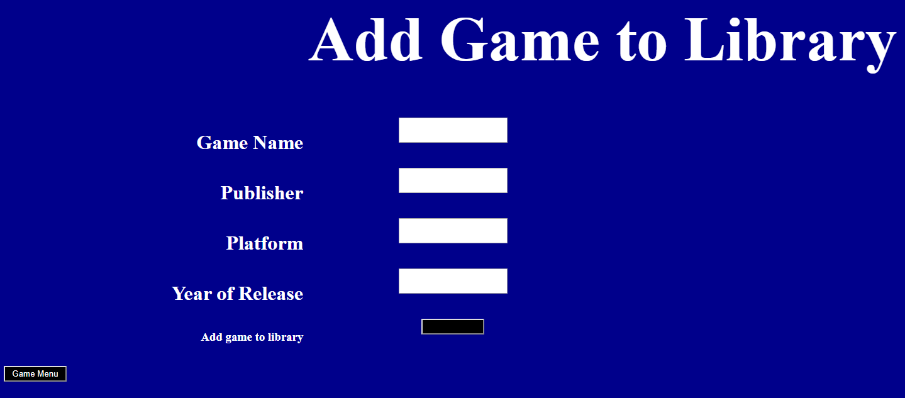
Front End

Slide 9
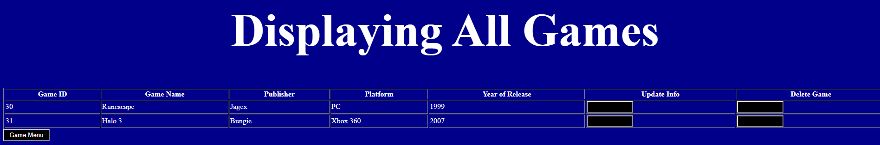
Front End

Slide 10
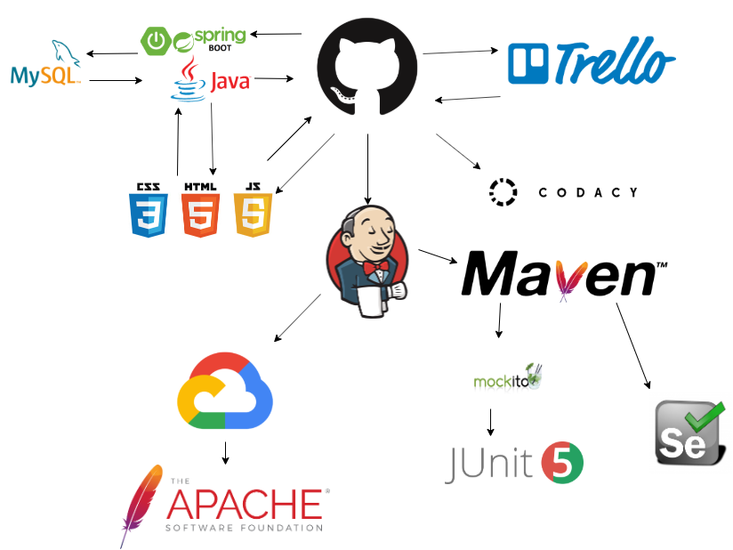
DevOps and CI Pipeline

Slide 11
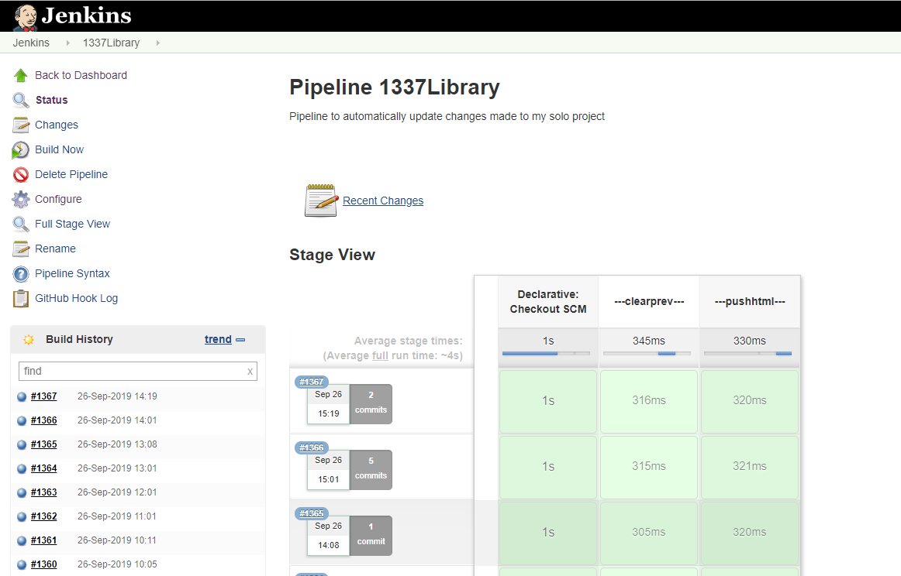
Jenkins

Slide 12
Summary
What went well:
Successfully created a database with 2 tables that contained CRUD functionality
100% code coverage with tests
Use of Jenkins as a CI Pipeline
Use of Feature Branches in VCS
Future Improvements:
Make the database relational
Make use of Docker
Use project tracking more frequently
User Interface can be improved
Incorporate more OOP principles

Slide 13
Demo
Click Here

Slide 14
Questions?

